Slide 1
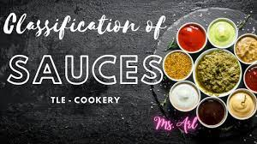
CLASSIFICATION OF SAUCES
Presented by
Urmi Das
Faculty
B.Voc (CTHM)

Slide 2
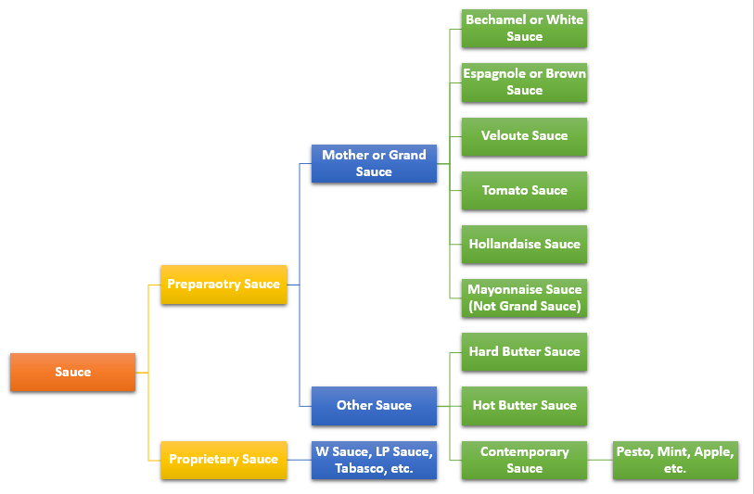
CLASSIFICATION OF SAUCES

Slide 3
SAUCES
Bechamel sauce is made by milk and white roux
Veloute sauce is prepared by white sauces and blond roux
Tomato sauce is made by tomato sauce
Espagnole sauce is made by brown stock and brown roux
Hollandaise sauce is an emulsion of oil, egg white, salt and pepper on double boiler in slow heat
Mayonnaise sauce is and emulsified sauce.

Slide 4


